Slide 1

Enhancing Career Guidance for Students through RAG​
Enhancing Career Guidance for Students through RAG​
B.Tech Project Review
Guide: Ms. Bindu K R
SL NO. | NAME | Roll No
1 | Akhil Swarop S | CB.EN.U4CSE21304
2 | Ganeshkaran M | CB.EN.U4CSE21312
3 | Hanish K R | CB.EN.U4CSE21317
4 | Hidesh Balaji C U | CB.EN.U4CSE21320
Team: 59

Slide 2
Enhancing Career Guidance for Students through RAG​
INTRODUCTION
This research explores the use of Retrieval-Augmented Generation (RAG) for personalized career guidance by comparing the performance of three large language models (LLMs):
Gemma 2 2B
Gemma 2 9B
Mistral 7B
Existing career guidance chatbots provide only general recommendations, but this study leverages FAISS retrieval and the O*NET job description dataset to generate tailored career advice from user resumes.
Gemma 2 9B, developed by Google DeepMind, is a 9-billion-parameter model optimized for efficient performance. Mistral 7B, a Large Language model from Mistral AI, utilizes 7B active parameters, making it faster than many dense 70B models.
Team: 59

Slide 3
Enhancing Career Guidance for Students through RAG​
INTRODUCTION
FAISS(Facebook AI Similarity Search) is used for efficient similarity search and clustering of dense vectors.
The O*NET dataset is embedded into dense vectors using a pretrained model, allowing FAISS to match user skills with the most relevant job descriptions.
This study is among the first to integrate these advanced LLMs with FAISS for career guidance. The research evaluates their performance in delivering specialized guidance, offering insights into their effectiveness in real-world applications.
Team: 59

Slide 4
Enhancing Career Guidance for Students through RAG​
PROBLEM STATEMENT & MOTIVATION
To design and evaluate a Retrieval-Augmented Generation (RAG) system that delivers personalized career guidance by leveraging user-specific data, such as academic skills , to improve the accuracy and relevance of career recommendations.
Team: 59

Slide 5
Enhancing Career Guidance for Students through RAG​
DATASET DESCRIPTION
Name | Description
O*Net Database | A collection of job titles and their descriptions, along with job codes for each job entry.
Resume Dataset | Labeled dataset created for finetuning the parsing model.
Team: 59

Slide 6
Enhancing Career Guidance for Students through RAG​
LITERATURE SURVEY -01
Ref # &Year | Title | Problem Statement | Dataset | Methodology
February 2023 | Scraping Google Scholar Data Using Cloud Computing Techniques [1] | The paper revolves around the challenges of collecting and analyzing unstructured data from the web, particularly from Google Scholar, and the need for effective scraping techniques to overcome these challenges. The proposed solution is a custom-built scraper that leverages specific methods and programming tools to enhance data collection efficiency. | Scraped and Unstructured data from Google Scholar | Developed a Python-based scraper utilizing Beautiful Soup and SERP API. The scraper has three components: Link Finding (identifies links) Data Extraction (extracts information), Data Storage (saves data in CSV format). Cloud computing was leveraged for scalability and efficiency.
Team: 59

Slide 7
Enhancing Career Guidance for Students through RAG​
LITERATURE SURVEY -02
Ref # &Year | Title | Problem Statement | Dataset | Methodology | Performance Metrics
04 October 2024 | Resspar: AI-Driven Resume Parsing and Recruitment System using NLP and Generative AI [2] | Develop a web-based resume parsing and recruitment system, "Resspar," that leverages NLP, Generative AI, and prompt engineering to streamline candidate selection processes for recruiters. The system should allow users to upload resumes in PDF format, parse relevant data such as names, emails, phone numbers, and skills using AI-driven algorithms, and store extracted information in a structured SQLite database for efficient retrieval and filtering. | Parsed Resume Data User Authentication Data: Job Role and Skill Criteria Text Index for Resumes and Job Descriptions | Natural Language Processing (NLP) Generative AI Data Extraction Algorithms SQLite Database Management Filtering Mechanism Security Measures | Accuracy of Data Extraction Processing Speed
Team: 59

Slide 8
Enhancing Career Guidance for Students through RAG​
NOVELTY
Traditional systems rely on static rules or generic recommendations. our use of Retrieval-Augmented Generation (RAG) allows the system to dynamically pull relevant academic, career, and market data to provide deeply personalized and context-aware guidance. Integrating the user’s skills into the retrieval process gives students relevant Job listings that’s relevant to both their abilities and real-world demand.
Team: 59

Slide 9
Enhancing Career Guidance for Students through RAG​
PROPOSED WORK PLAN
User Profile and Data Collection Module
Knowledge Base Construction and Management Module
Retrieval-Augmented Generation (RAG) Module
Data Preprocessing and Normalization Module
Sequential Workflow
Team: 59

Slide 10
Enhancing Career Guidance for Students through RAG​
Modules
User Profile and Data Collection Module
Data Preprocessing Module
Semantic Retrieval Module
Retrieval Augmented Generation (RAG) Module
Evaluation Module
Team: 59

Slide 11
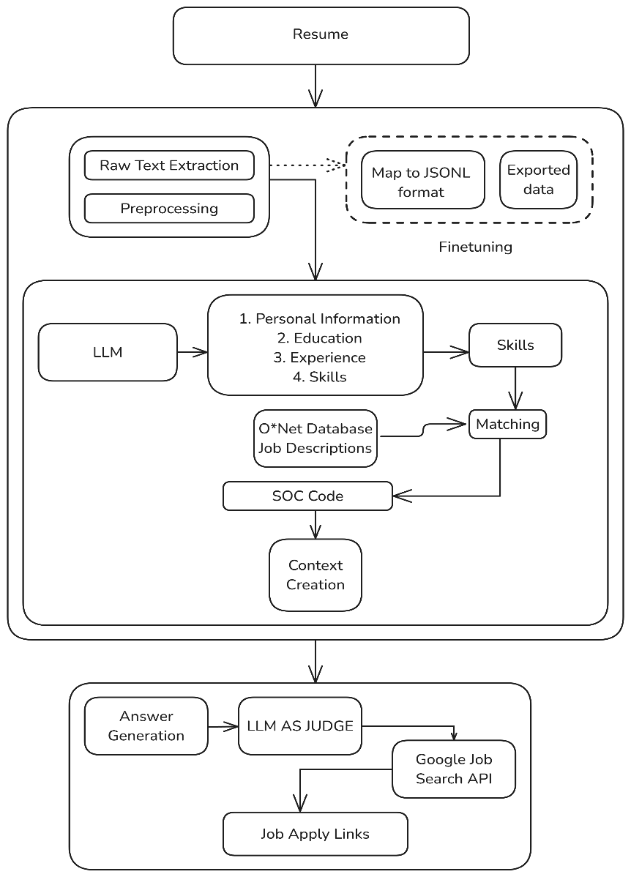
Enhancing Career Guidance for Students through RAG​
ARCHITECTURE DIAGRAM
Team: 59

Slide 12
Enhancing Career Guidance for Students through RAG​
MODULE WISE DESCRIPTION
User Profile and Data collection Module:
Collects and manages comprehensive user data, including academic history, skills. This module serves as the foundation for generating personalized recommendations.
Team: 59

Slide 13
Enhancing Career Guidance for Students through RAG​
MODULE WISE DESCRIPTION
Data Preprocessing Module:
Processes raw user data and external datasets to prepare them for effective retrieval and analysis. It normalizes and enriches data to align with standardized formats and taxonomies
Team: 59

Slide 14
Enhancing Career Guidance for Students through RAG​
MODULE WISE DESCRIPTION
Semantic Retrieval Module:
Retrieves relevant documents and information from the knowledge base that align with the user's profile, focusing on emerging research areas and career opportunities that match the user's expertise and interests.
Team: 59

Slide 15
Enhancing Career Guidance for Students through RAG​
MODULE WISE DESCRIPTION
Retrieval Augmented Generation Module:
Integrates retrieved information with generative AI models to create personalized and context-rich recommendations for research topics or career paths.
Team: 59

Slide 16
Enhancing Career Guidance for Students through RAG​
MODULE WISE DESCRIPTION
Evaluation Module:
Evaluates the generation of the generations of the models basis Answer Relevancy , Faithfulness and Hallucination Scores.
Additionally, standardized scores like BLEU, BERT, SMS, ROUGE have been used to evaluate the generations, using the generation of Deepseek 14B model as the reference text
BLEU - Bilingual Evaluation Understudy
BERT - Bidirectional Encoder Representations from Transformers
SMS - Semantic Matching Score
ROUGE - Recall-Oriented Understudy for Gisting Evaluation
Team: 59

Slide 17
Enhancing Career Guidance for Students through RAG​
MODULE WISE DESCRIPTION
Answer Relevancy :
The answer relevancy metric uses LLM-as-a-judge to measure the quality of the RAG pipeline's generator by evaluating how relevant the actual output of the LLM application is compared to the provided input.
2. Faithfulness :
The faithfulness metric uses LLM-as-a-judge to measure the quality of the RAG pipeline's generator by evaluating whether the actual output factually aligns with the contents of the retrieval context.
3. Hallucination :
The hallucination metric uses LLM-as-a-judge to determine whether the LLM generates factually correct information by comparing the actual output to the provided context.
Team: 59

Slide 18
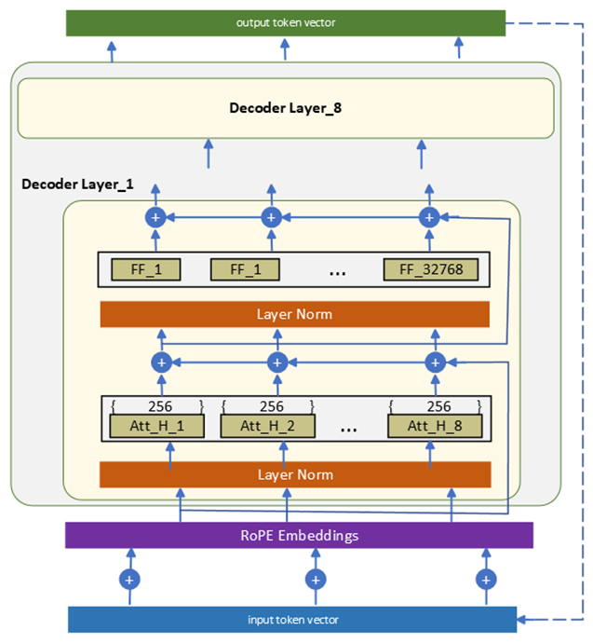
Enhancing Career Guidance for Students through RAG​
Gemma2
Parameters Used:
Model: google/gemma-2-2b-it
Tokenizer: AutoTokenizer associated with the Gemma-2 2B model. [3]
Quantization Config: Weights: int8
Device Map: "cuda" (layers are automatically distributed across
GPUs/CPU)
Torch Data Type: float16 (except for the 4-bit quantized layers)
Text Generation Pipeline:
use_cache=True
max_length=5000
do_sample=True
top_k=5
num_return_sequences=1
eos_token_id and pad_token_id: From the tokenizer's eos_token_id
JSON Schema Enforcer: lmformatenforcer.JsonSchemaParser is used to ensure that the output conforms strictly to the expected structure.
Team: 59

Slide 19
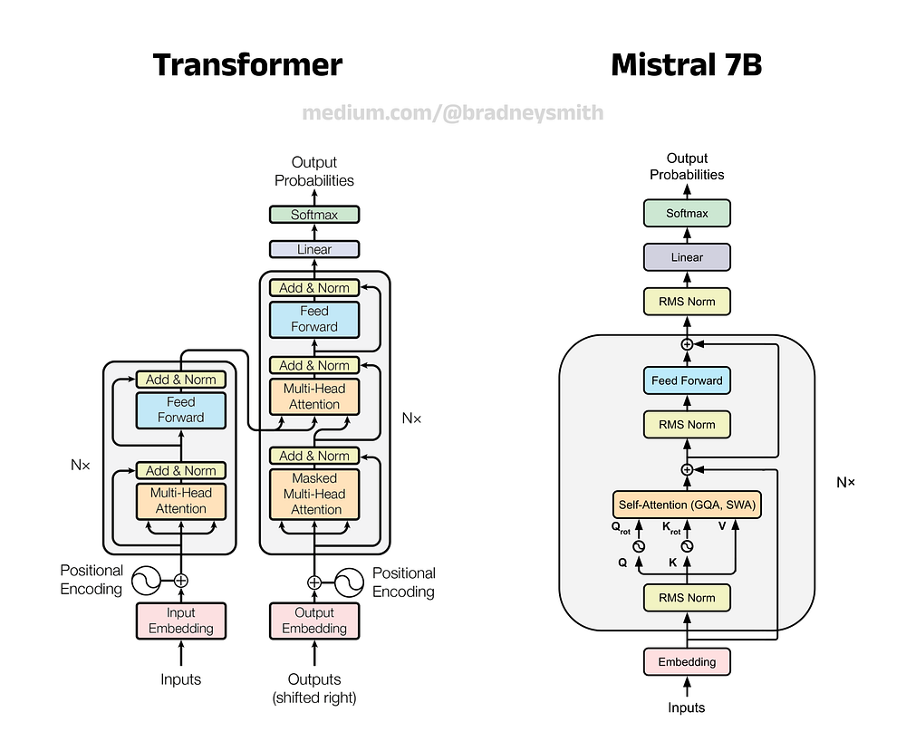
Enhancing Career Guidance for Students through RAG​
Mistral [4]
Parameters Used:
Model: mistral
Prompt Structure:
Context: Top-K retrieved documents (via FAISS and
O*NET job titles/descriptions)
User Profile: Includes skills and academic history.
Guidance Requirements:
Recommended career paths (SOC codes and titles)
Skill development suggestions
Industries to explore
Next steps for job applications
Subprocess Execution: Mistral is executed
using ollama with a specific prompt for personalized career guidance generation.
Team: 59

Slide 20
RESULT ANALYSIS
Enhancing Career Guidance for Students through RAG​
Metric | Score
Answer Relevancy | 0.9494
Faithfulness | 0.9671
Hallucination | 0.0666
Metrics for Gemma 2 2B
Explanation :
Answer Relevancy : The Score is 0.9494 because the user profile provides enough context to recommend specific career paths or suggest skill development.
Faithfulness :The faithfulness score is 0.9671 because the actual outputs perfectly align with the retrieval context
Hallucination : The Hallucination score is 0.0666 because there is no discrepancy between the generated output and provided con-text
Team: 59

Slide 21
RESULT ANALYSIS
Enhancing Career Guidance for Students through RAG​
Metric | Score
Answer Relevancy | 0.9907
Faithfulness | 0.9852
Hallucination | 0.0476
Metrics for Mistral
Explanation :
Answer Relevancy : The Score is 0.9907 because although the Provided context Gives a Comprehensive list of Healthcare occupations , it doesn’t offer any specific guidance on how to levarage the user’s skills and interests to deter-mine their ideal career path
Faithfulness :The score is 0.9852 because the provided output utilises the retrieval context by reflecting the required skills for the SOC codes listed, specifically patient assessment and HIPAA compliance
Hallucination : The score is 0.0476 due to factual alignments, and almost no hallucination
Team: 59

Slide 22
RESULT ANALYSIS
Enhancing Career Guidance for Students through RAG​
Metric | Score
Answer Relevancy | 0.9881
Faithfulness | 0.9701
Hallucination | 0.02
Metrics for Gemma 2 9B
Explanation :
Answer Relevancy : The Score is 0.9881 because the user profile does not specify any aca-demic or Vocational qualifications and does not have any specific career goals . Therefore, it’s challenging to provide a personalized career path. However , based on the skills men-tioned, the AI career advisor can offer suggestions for exploration and development , such as suggesting relevant courses , certifications or net-working opportunities within the the healthcare field
Faithfulness :The faithfulness score is 0.9701 because there are no contradictions .
Hallucination : The score is 0.02 because no hallucination information was found
Team: 59

Slide 23
RESULT ANALYSIS
Enhancing Career Guidance for Students through RAG​
Metric | Gemma 2 2B | Gemma 2 9B | Mistral
BLEU | 0.07 | 0.08 | 0.17
ROUGE | 0.21 | 0.24 | 0.25
BERT | 0.85 | 0.85 | 0.87
SMS | 0.77 | 0.79 | 0.87
Performance Metrics Comparison Across Models
The observed results indicate that Mistral outperforms both the Gemma models.
All three models display a very high score of BERT and SMS which indicates a high good semantic similarity. The BLEU and ROUGE scores indicates scope for improvement in fluency and recall.
Team: 59

Slide 24
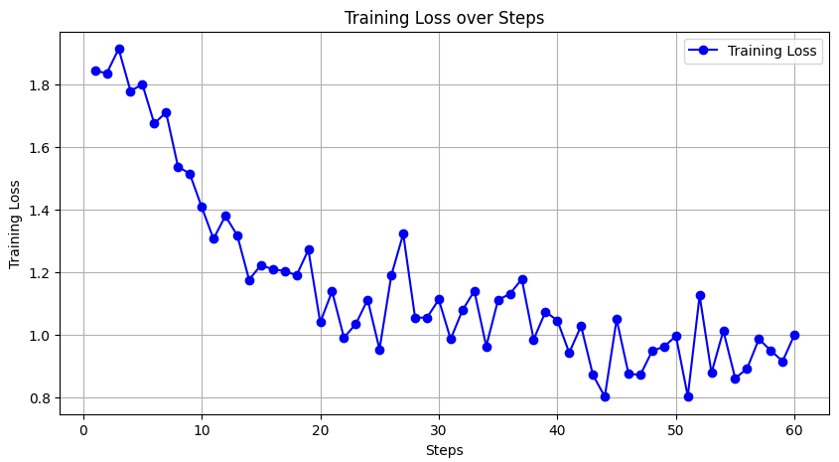
Enhancing Career Guidance for Students through RAG​
RESULT ANALYSIS Gemma 2 2B Model Training
Team: 59

Slide 25
Enhancing Career Guidance for Students through RAG​
CONCLUSION
While the existing framework provides a good foundation for local LLM execution, future revisions should prioritize performance optimization, dataset growth, and infrastructure improvements to increase efficiency and usability. By improving the BLEURT scores, upgrading job role databases, expanding the resume parsing dataset, and investigating cloud-based LLM hosting, we can provide a more powerful and responsive system that can react to the continuously changing employment market.
Team: 59

Slide 26
Enhancing Career Guidance for Students through RAG​
FUTURE ENHANCEMENT
Gemma 2 9B
Gemma 2 2B
Mistral 7B
All three models show a high degree of semantic similarity to the recently published state-of-the-art Deepseek-R1 14B model, according to our evaluation. This implies that our optimized solution can produce results that are comparable across a range of benchmark tests, even with the variances in architecture and parameter scales.
Opportunities for Performance and Optimization : Even while the existing architecture produces encouraging results, it can still be improved .
Future advancements might concentrate on optimization techniques like : Fine-tuning with domain-specific datasets: Contextual comprehension may be enhanced by adding more job descriptions, industry-specific terminology, and actual resumes to training data.
Team: 59

Slide 27
Enhancing Career Guidance for Students through RAG​
FUTURE ENHANCEMENT
Enhancing RAG-based methods for retrieval mechanisms:
More effective indexing strategies, embeddings, or reranking models could improve retrieval quality if the system makes use of RAG (Retrieval-Augmented Generation). Examining a Remote LLM Configuration Our local LLM deployment at the moment guarantees user control and privacy, but it comes at the expense of slower processing performance, particularly for bigger models. There may be bottlenecks in CPU/GPU performance, memory bandwidth, and VRAM availability while running inference on consumer hardware.
These difficulties might be lessened by a remote setup via:
To take use of high-performance computing resources, the LLM is being deployed on cloud-based GPUs (such as AWS, Google Cloud, or Azure).
Team: 59

Slide 28
Enhancing Career Guidance for Students through RAG​
PUBLICATION DETAILS
[1]. Akhil Swarop,S., Ganeshkaran,M., Hanish,K.R., Hidesh Balaji,C.U., Bindu,K.R. (2025). Enhancing Career Guidance for Students through Retrieval Augmented Generation. In 2025 8th International conference on Inventive Computation Technologies (ICICT 2025). IEEE. (Accepted)
Conference Name : ICICT 2025
Presentation Date: 25th April, 2025
Status: Paper Accepted
Team: 59

Slide 29
Enhancing Career Guidance for Students through RAG​
REFERENCES
[1] Sultan, N. A., & Abdullah, D. B. (2022, August). Scraping google scholar data using cloud computing techniques. In 2022 8th International Conference on Contemporary Information Technology and Mathematics (ICCITM) (pp. 14-19). IEEE.
[2] Abisha, D., Keerthana, S., Navedha Evanjalin, R., Kavitha, K., Jothi Mary, S., & Ramya, R. (2024, August). Resspar: AI-Driven Resume Parsing and Recruitment System using NLP and Generative AI. In 2024 Second International Conference on Intelligent Cyber Physical Systems and Internet of Things (ICoICI) (pp. 1-6). IEEE..
[3] Team, G., Riviere, M., Pathak, S., Sessa, P. G., Hardin, C., Bhupatiraju, S., ... & Garg, S. (2024). Gemma 2: Improving open language models at a practical size. arXiv preprint arXiv:2408.00118.
[4] Bendi-Ouis, Y., Dutartre, D., & Hinaut, X. (2024). Deploying Open-Source Large Language Models: A performance Analysis. arXiv preprint arXiv:2409.14887.
[5] He, Z., Zhong, Z., Cai, T., Lee, J. D., & He, D. (2023). Rest: Retrieval-based speculative decoding. arXiv preprint arXiv:2311.08252.
[6] Wang, Z., Wu, J., Lai, Y., Zhang, C., & Zhou, D. (2024). Seed: Accelerating reasoning tree construction via scheduled speculative decoding. arXiv preprint arXiv:2406.18200.
[7] Huang, K., Guo, X., & Wang, M. (2024). Specdec++: Boosting speculative decoding via adaptive candidate lengths. arXiv preprint arXiv:2405.19715.
[8] Rao, J., & Lin, J. (2024). RAMO: Retrieval-Augmented Generation for Enhancing MOOCs Recommendations. arXiv preprint arXiv:2407.04925.
[9] Ru, D., Qiu, L., Hu, X., Zhang, T., Shi, P., Chang, S., ... & Zhang, Z. (2024). Ragchecker: A fine-grained framework for diagnosing retrieval-augmented generation. Advances in Neural Information Processing Systems, 37, 21999-22027.
[10] Salemi, A., & Zamani, H. (2024, July). Evaluating retrieval quality in retrieval-augmented generation. In Proceedings of the 47th International ACM SIGIR Conference on Research and Development in Information Retrieval (pp. 2395-2400).
Team: 59

Slide 30
Enhancing Career Guidance for Students through RAG​
REFERENCES
[11] Wang, Y., Li, P., Sun, M., & Liu, Y. (2023). Self-knowledge guided retrieval augmentation for large language models. arXiv preprint arXiv:2310.05002.
[12] Liu, Y., Yavuz, S., Meng, R., Radev, D., Xiong, C., & Zhou, Y. (2022). Uni-parser: Unified semantic parser for question answering on knowledge base and database. arXiv preprint arXiv:2211.05165.
[13] Zhang, X., Wang, M., Yang, X., Wang, D., Feng, S., & Zhang, Y. (2024). Hierarchical Retrieval-Augmented Generation Model with Rethink for Multi-hop Question Answering. arXiv preprint arXiv:2408.11875.
[14] Thway, M., Recatala-Gomez, J., Lim, F. S., Hippalgaonkar, K., & Ng, L. W. (2024). Battling Botpoop using GenAI for higher education: A study of a retrieval augmented generation chatbots impact on learning. arXiv preprint arXiv:2406.07796.
[15] Joshi, P., Gupta, A., Kumar, P., & Sisodia, M. (2024, June). Robust multi model rag pipeline for documents containing text, table & images. In 2024 3rd International Conference on Applied Artificial Intelligence and Computing (ICAAIC) (pp. 993-999). IEEE.
[16] Stanchev, L. (2015, February). Semantic search using a similarity graph. In Proceedings of the 2015 IEEE 9th International Conference on Semantic Computing (IEEE ICSC 2015) (pp. 93-100). IEEE.
[17] Abisha, D., Keerthana, S., Navedha Evanjalin, R., Kavitha, K., Jothi Mary, S., & Ramya, R. (2024, August). Resspar: AI-Driven Resume Parsing and Recruitment System using NLP and Generative AI. In 2024 Second International Conference on Intelligent Cyber Physical Systems and Internet of Things (ICoICI) (pp. 1-6). IEEE.
[18] Yang, Y., Li, Z., Dong, Q., Xia, H., & Sui, Z. (2024). Can Large Multimodal Models Uncover Deep Semantics Behind Images?. arXiv preprint arXiv:2402.11281.
[19] Team, G., Riviere, M., Pathak, S., Sessa, P. G., Hardin, C., Bhupatiraju, S., ... & Garg, S. (2024). Gemma 2: Improving open language models at a practical size. arXiv preprint arXiv:2408.00118.
[20] Han, Z., Gao, C., Liu, J., Zhang, J., & Zhang, S. Q. (2024). Parameter-efficient fine-tuning for large models: A comprehensive survey. arXiv preprint arXiv:2403.14608.
[21] Hu, E. J., Shen, Y., Wallis, P., Allen-Zhu, Z., Li, Y., Wang, S., ... & Chen, W. (2021). Lora: Low-rank adaptation of large language models. arXiv 2021. arXiv preprint arXiv:2106.09685.
Team: 59

Slide 31
Enhancing Career Guidance for Students through RAG​
QUESTIONS
Team: 59

Slide 32
Enhancing Career Guidance for Students through RAG​
THANK YOU
Team: 59

